Slide 1


www.studymafia.org
Seminar
On
Computer Forensics
Submitted To: Submitted By:
www.studymafia.org www.studymafia.org
Notes:
1
1

Slide 2
CONTENTS
Introduction
What is Computer Forensics?
Characteristics
Needs
History
Goal
Cyber Crime & Evidence
Rules Of Handling Evidence
Top 10 Location For Evidence
Computer Forensics Methodology
Applications of Computer Forensics
Who Uses Computer Forensics
Skills Requirements for Computer Forensics
Conclusion
References

Slide 3
Introduction
“Forensic computing is the process of identifying, preserving, analyzing and presenting digital evidence in a manner that is legally acceptable.”(Rodney Mckemmish 1999).

Slide 5
Seminar topic on computer forensics

Slide 8
What is Computer Forensics?
“Forensic computing is the process of identifying, preserving, analyzing and presenting digital evidence in a manner that is legally acceptable.”(Rodney Mckemmish 1999).
Evidence might be required for a wide range of computer crimes and misuses.
Information collected assists in arrests, prosecution, termination of employment, and preventing future illegal activity

Slide 9
Characteristics
IDENTIFYING
PRESERVING
ANALYZING
PRESENTING

Slide 10
NEEDS OF COMPUTER FORENSICS
To produce evidence in the court that can lead to the punishment of the actual.
To ensure the integrity of the computer system.
To focus on the response to hi-tech offenses, started to intertwine.

Slide 11
HISTORY OF COMPUTER FORENSICS
Began to evolve more than 30 years ago in US when law enforcement and military investigators started seeing criminals get technical.
Over the next decades, and up to today, the field has exploded. Law enforcement and the military continue to have a large presence in the information security and computer forensic field at the local, state and federal level.
Now a days, Software companies continue to produce newer and more robust forensic software programs. And law enforcement and the military continue to identify and train more and more of their personnel in the response to crimes involving technology.

Slide 12
GOAL OF COMPUTER FORENSICS
The main goal of computer forensic experts is not only to find the criminal but also to find out the evidence and the presentation of the evidence in a manner that leads to legal action of the criminal.

Slide 13
CYBER CRIME & EVIDENCE
CYBER CRIME
Cyber crime occurs when information technology is used to commit or conceal an offence.

Slide 14
Types of Cyber Crime
Forgery
Breech of Computer Security
Fraud/Theft
Copyright Violations
Identity Theft
Threats
Burglary
Homicide
Administrative Investigations
Cyber Terrorism
Sales and Investment Fraud
Electronic Fund Transfer Fraud

Slide 15
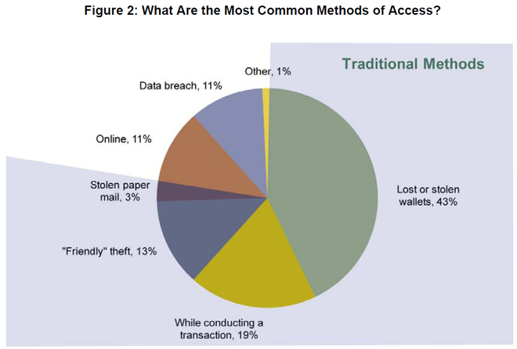

Slide 16
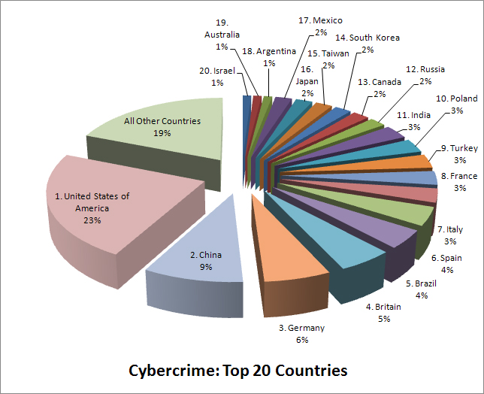
Cybercrime: Top 20 Countries

Slide 17
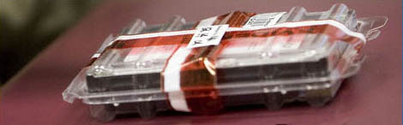
Evidence
An item does not become officially a piece of evidence until a court admits it.
Much of forensics practice concerns how to collect, preserve and analyze these items without compromising their potential to be admitted as evidence in a court of law.

Slide 18
DIGITAL EVIDENCE
“Any data that is recorded or preserved on any medium in or by a computer system or other similar device, that can be read or understand by a person or a computer system or other similar device. It includes a display, print out or other output of that data.”

Slide 19
TYPES OF DIGITAL EVIDENCE
1) PERSISTANT DATA
Meaning data that remains intact when the computer is turned off. E.g. hard drives, disk drives and removable storage devices (such as USB drives or flash drives).
2) VOLATILE DATA,
Meaning data that would be lost if the computer is turned off. E.g. deleted files, computer history, the computer's registry, temporary files and web browsing history.

Slide 20
5 RULES OF EVIDENCES
Admissible
Must be able to be used in court or elsewhere.
Authentic
Evidence relates to incident in relevant way.
Complete (no tunnel vision)
Exculpatory evidence for alternative suspects.
Reliable
No question about authenticity & veracity.
Believable
Clear, easy to understand, and believable by a jury.

Slide 21
TOP 10 LOCATION FOR EVIDENCE
Internet History Files
Temporary Internet Files
Slack/Unallocated Space
Buddy lists, personal chat room records, others saved areas
News groups/club lists/posting
Settings, folder structure, file names
File Storage Dates
Software/Hardware added
File Sharing ability
E-mails

Slide 22
Methodology
1) Shut Down the Computer
2) Document the Hardware Configuration of The System
3) Transport the Computer System to A Secure Location
4) Make Bit Stream Backups of Hard Disks and Floppy Disks
5) Mathematically Verify Data on All Storage Devices
6) Document the System Date and Time
7) Make a List of Key Search Words

Slide 23
CONT…
8) Evaluate the Windows Swap File
9) Evaluate File Slack
10) Evaluate Unallocated Space (Erased Files)
11) Search Files, File Slack and Unallocated Space for Key Words
12) Document File Names, Dates and Times
13) Identify File, Program and Storage Anomalies
14) Evaluate Program Functionality
15) Document Your Findings

Slide 24
Applications
FINANCIAL FRAUD DETECTION
CRIMINAL PROSECUTION
CIVIL LITIGATION
“CORPORATE SECURITY POLICY AND VIOLATIONS”

Slide 25
Who Uses Computer Forensics?
Criminal Prosecutors
Rely on evidence obtained from a computer to prosecute suspects and use as evidence.
Civil Litigations
Personal and business data discovered on a computer can be used in fraud, harassment, or discrimination cases.
Private Corporations
Obtained evidence from employee computers can be used as evidence in harassment, fraud, and embezzlement cases.

Slide 26
Who Uses Computer Forensics? (cont..)
Law Enforcement Officials
Rely on computer forensics to backup search warrants and post-seizure handling.
Individual/Private Citizens
Obtain the services of professional computer forensic specialists to support claims of harassment, abuse, or wrongful termination from employment.

Slide 27
Skills Required For Computer Forensics Application
Programming or computer-related experience
Broad understanding of operating systems and applications
Strong analytical skills
Strong computer science fundamentals
Strong system administrative skills
Knowledge of the latest intruder tools
Knowledge of cryptography and steganography
Strong understanding of the rules of evidence and evidence handling
Ability to be an expert witness in a court of law

Slide 28
Conclusion
With computers becoming more and more involved in our everyday lives, both professionally and socially, there is a need for computer forensics.
This field will enable crucial electronic evidence to be found, whether it was lost, deleted, damaged, or hidden, and used to prosecute individuals that believe they have successfully beaten the system.

Slide 29
References
www.google.com
www.wikipedia.com
www.studymafia.org

Slide 30
Thanks

